Slide 1
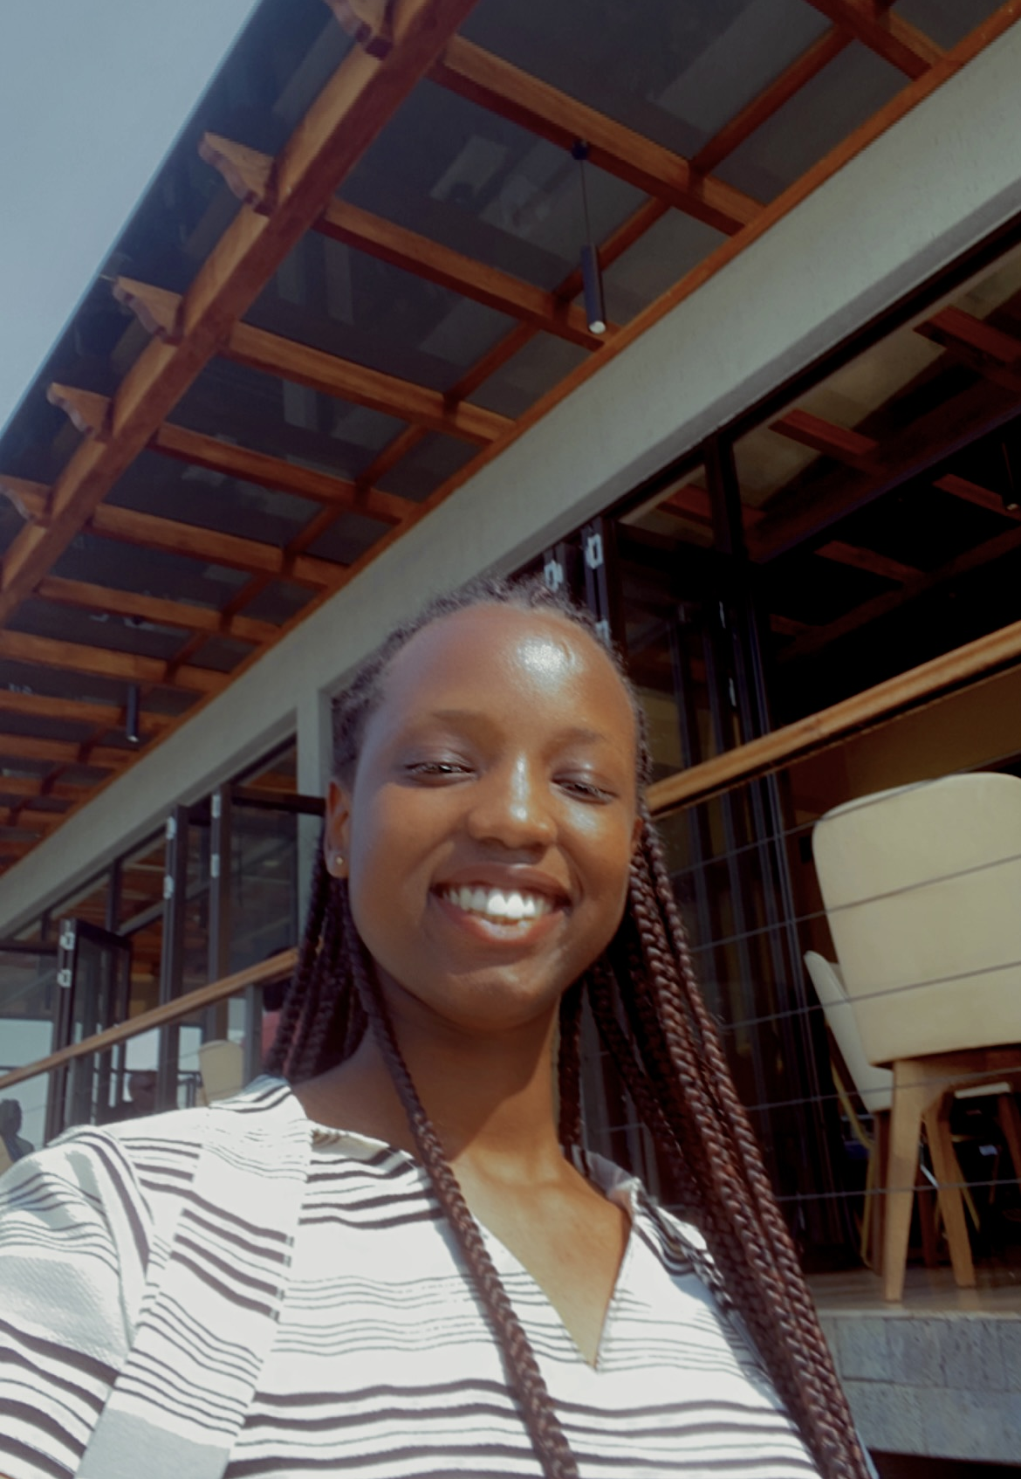
PERSONAL INTRODUCTION: TETA STELLA & LinkedIn
My name is Teta Anny Stella, I am currently enrolled in Software engineering at Adventist University of Central Africa, and I’m in my second year.
I constantly use digital tools such as code editors, search engines and other academic resources to enhance my learning, complete projects, and learn more about the world of software development.
I expect to gain experience with PL/SQL, and learn how to design, implement, and manage databases. I also hope to understand more about advanced database concepts.
What you may not know about me is I have only ever been to three other countries but would like to see more.

